Slide 1
Intro to Radio frequency
SDR STEM CAMP
Developed by: Spencer Grady & Hunter Litke

Slide 2


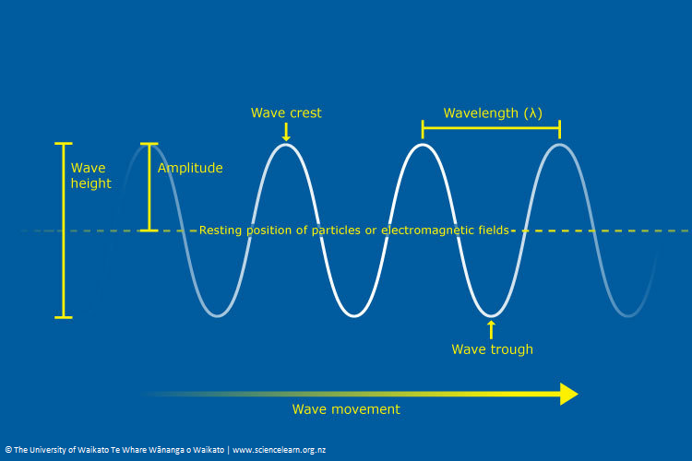
Electromagnetic waves
Electromagnetic (EM) waves are a form of radiation that travel through the universe. An EM wave is created because of vibrations between an electric and magnetic field.
Wavelength is the distance between two crests or two troughs.
Amplitude is the amount of energy transferred by the wave.
Frequency is the number of wavelengths that pass through a point in each time (usually 1 second).

Slide 3
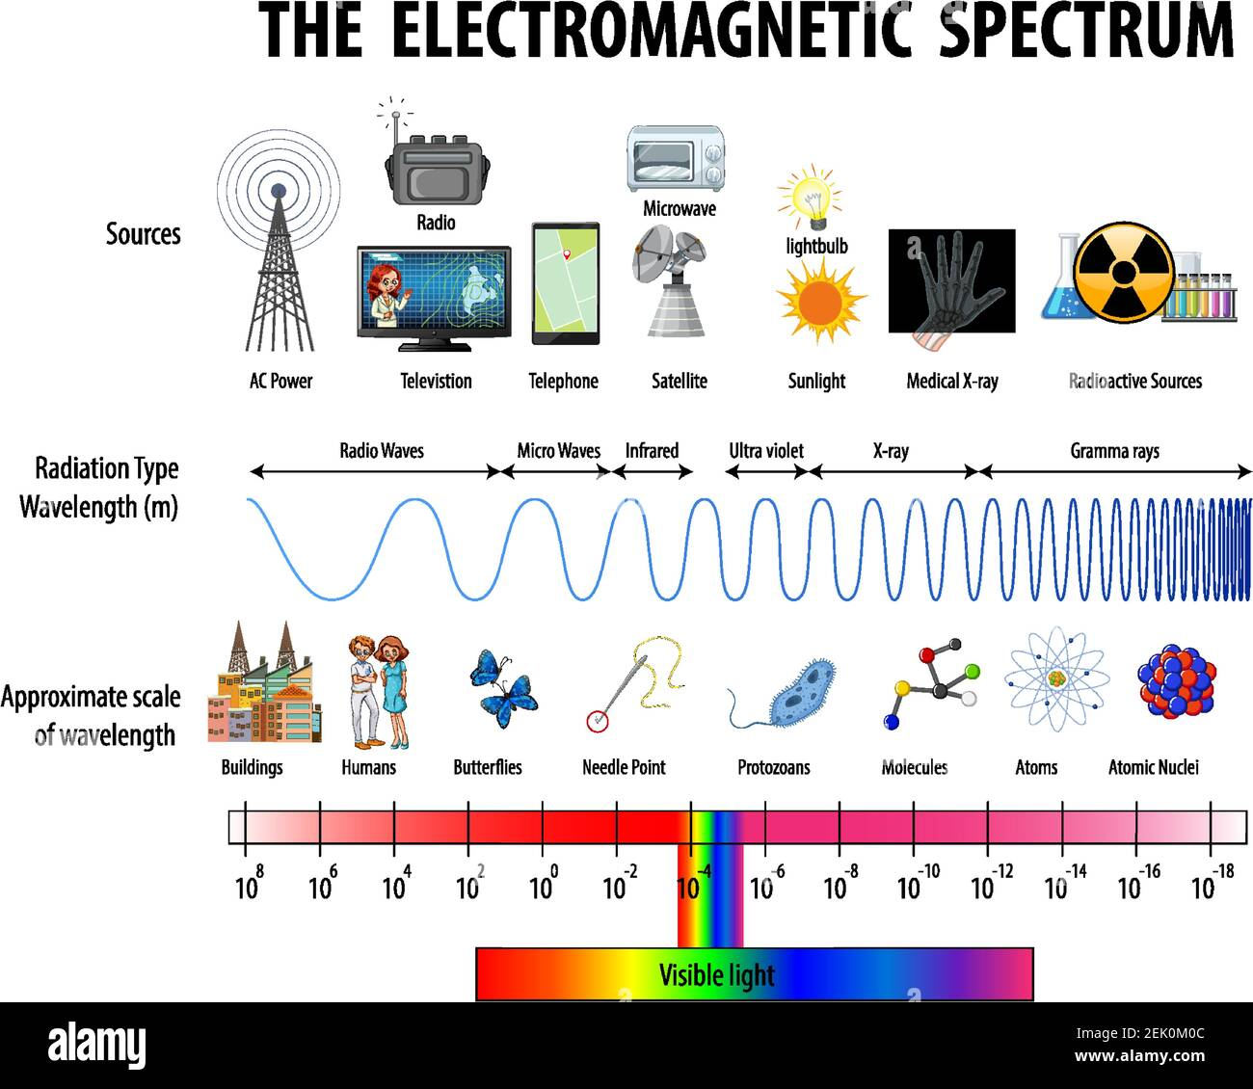
Notes:
On this slide, the instructor should encourage conversation about real world examples of EM waves that the students know of and maybe never thought about the physics behind them.
Ask the students, do they notice a correlation in in wavelength and harmfulness to humans?
What products do they use everyday that produce EM waves?
*** INSTRUCTORS be sure to point out the last bullet for a "GOTCHA" moment ***
The answer to the above question is technically EVERYTHING. EM waves make up the visibile light spectrum, therefore everything we see, touch, and hear are tied to EM waves.

Slide 4
RF Basics
A signal is considered RF when its frequency is greater than 300 MHz.
A carrier signal is a high-frequency signal the carries the "real" information signals of the data. A carrier signal is needed because of the small size of modern electronics.
A baseband signal is an analog signal that carries the information.

Slide 5
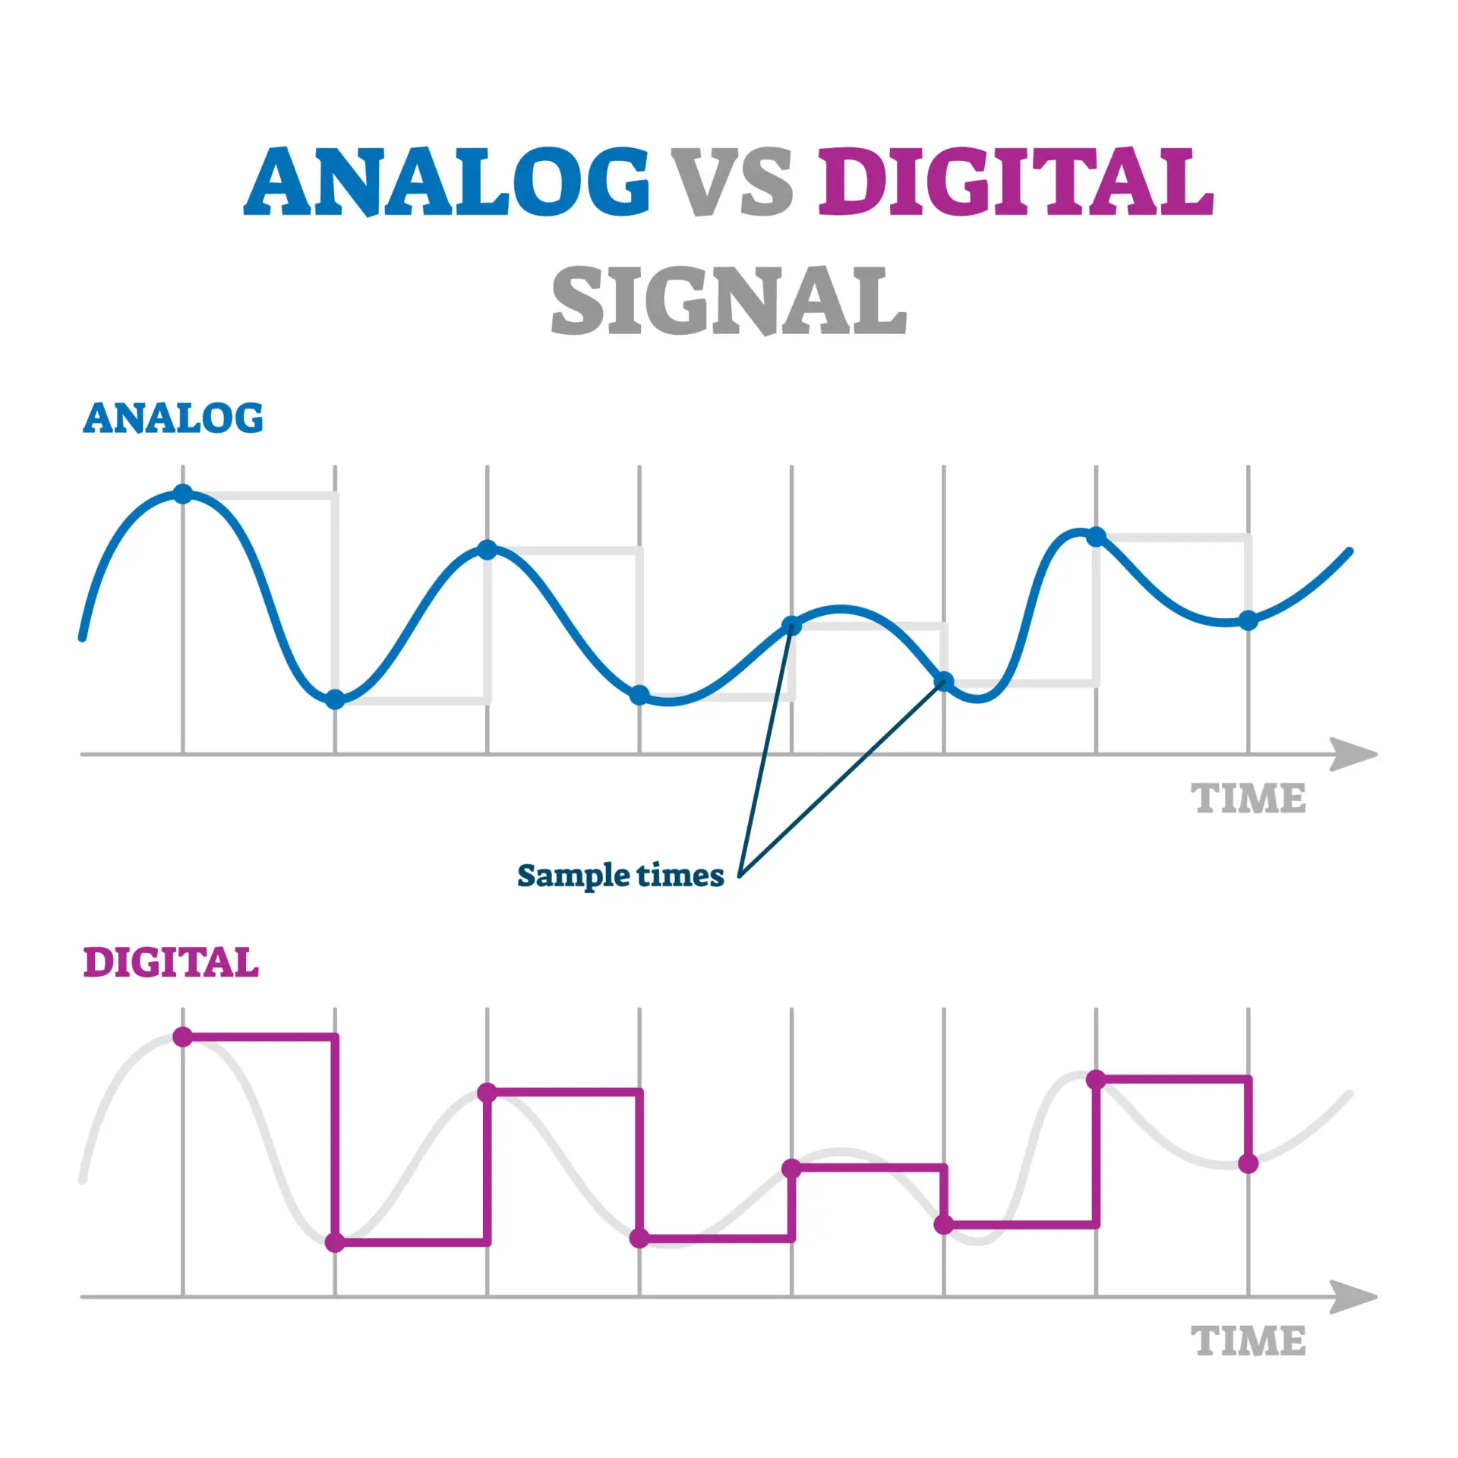
RF Basics
An analog signal represents data through continual fluctuations
A digital signal represents data through specific discrete values.

Slide 6
RF Basics
Modulation means encoding the signal .
Why would we want to modulate a signal?
Modulating signals is what allows us to have wireless connections.
Modulating the signal can increase the strength of the signal and can travel further.
Without signal modulation, we would have to have wired connections for even the longest signal travel distances!
Notes:
Students can think of modulation as "disguising" the signal into a new signal that is easier to transport

Slide 7
RF Basics
Demodulation means decoding the signal from its modulated or "encoded" state.
Signals can me modulated and demodulated by using hardware or software components.
Notes:
Students can think of demodulating a signal as "removing the disguise" so that you can find out what data the signal is actually carrying

Slide 8
RF basics
RF Transmission
An RF signal is created by upshifting a low bandwidth signal to radio frequency by a radio transmitter
RF Reception
An RF signal is picked up by an antenna and downshifted back to a low bandwidth signal by a radio receiver
Notes:
Transmissions is SENDING the signal
Reception is RECEIVING the signal

Slide 9
Radio Waves
Radio waves have the largest wavelength of any EM wave type, which makes them the least harmful to humans.
Gamma rays have the shortest wavelength, which make them EXTREMELY harmful to humans.
Radio waves are used in radio broadcasts, civilian and military communication systems, radar systems, and much more.
Notes:
On this slide, the instructor should point out the correlation of wavelength and harmfulness
Create brainstorm other areas that radio waves, or EM waves in general have applications.

Slide 10
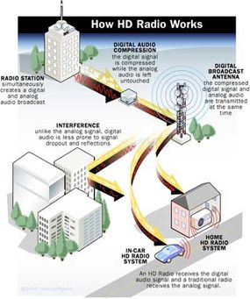
FM Radio Stations
Radio stations do not broadcast directly to your car, there are middle-men that the signal goes through.
Radio waves are rarely affected by interference (Large structures in this case). Therefor, there does not have be a direct path between the antenna and your vehicle.
Notes:
Why the focus on radio stations? Students will use the RTL-SDR to create their own radio and listen to the station for the lab!
Radio stations do not send their signal directly to your car radio
Digital Audio Compression: This reduces the size of the overall signal but the contents remain unaffected
Digital Broadcast Antenna: This is the device that takes the compressed audio signal and broadcasts it out for listeners (radios) to receive.

Slide 11
Activity
Now that you’ve learned all about EM waves and in detail about RF signals, lets practice!
We will use the RTL-SDR to listen to an FM radio station!

Slide 12
References
https://www.hwe.design/design-fundamentals/rf-basics/rf-fundamentals

